Slide 1

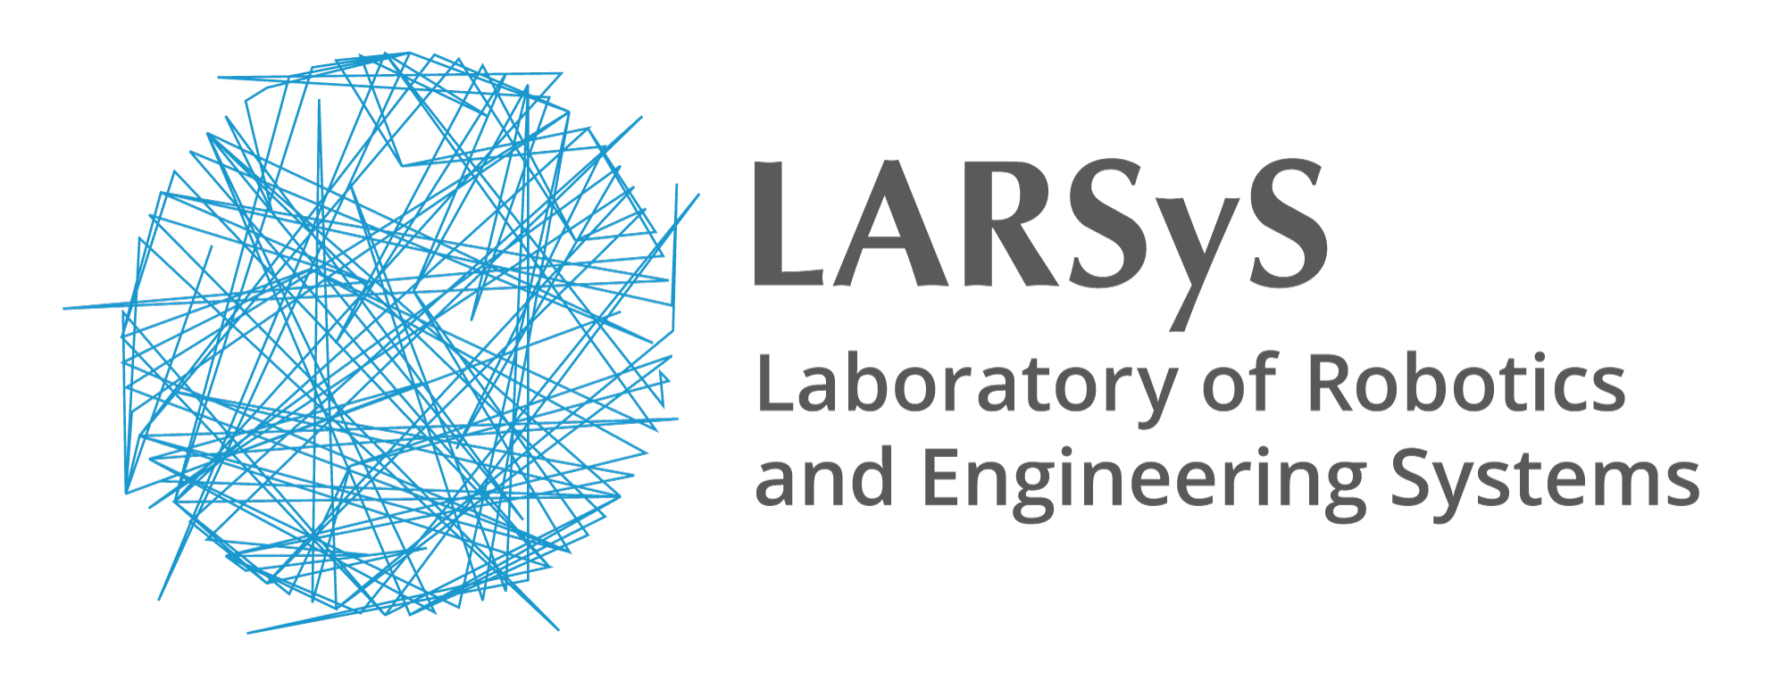




1º Fórum - Inovação em Medicina e Engenharia Biomédica: Sinergias e Desafios
ULTRASOUND IMAGE DENOISING WITH DEEP LEARNING
Diogo Fróis Vieira¹, Afonso Raposo¹, António Azeitona¹, Manya Afonso², Luís Mendes Pedro³, and J. Sanches¹
¹
¹
¹
²
³
24 de Setembro 2024 - Reitoria da Universidade Nova de Lisboa
Notes:
SLIDE CAPA

Slide 2
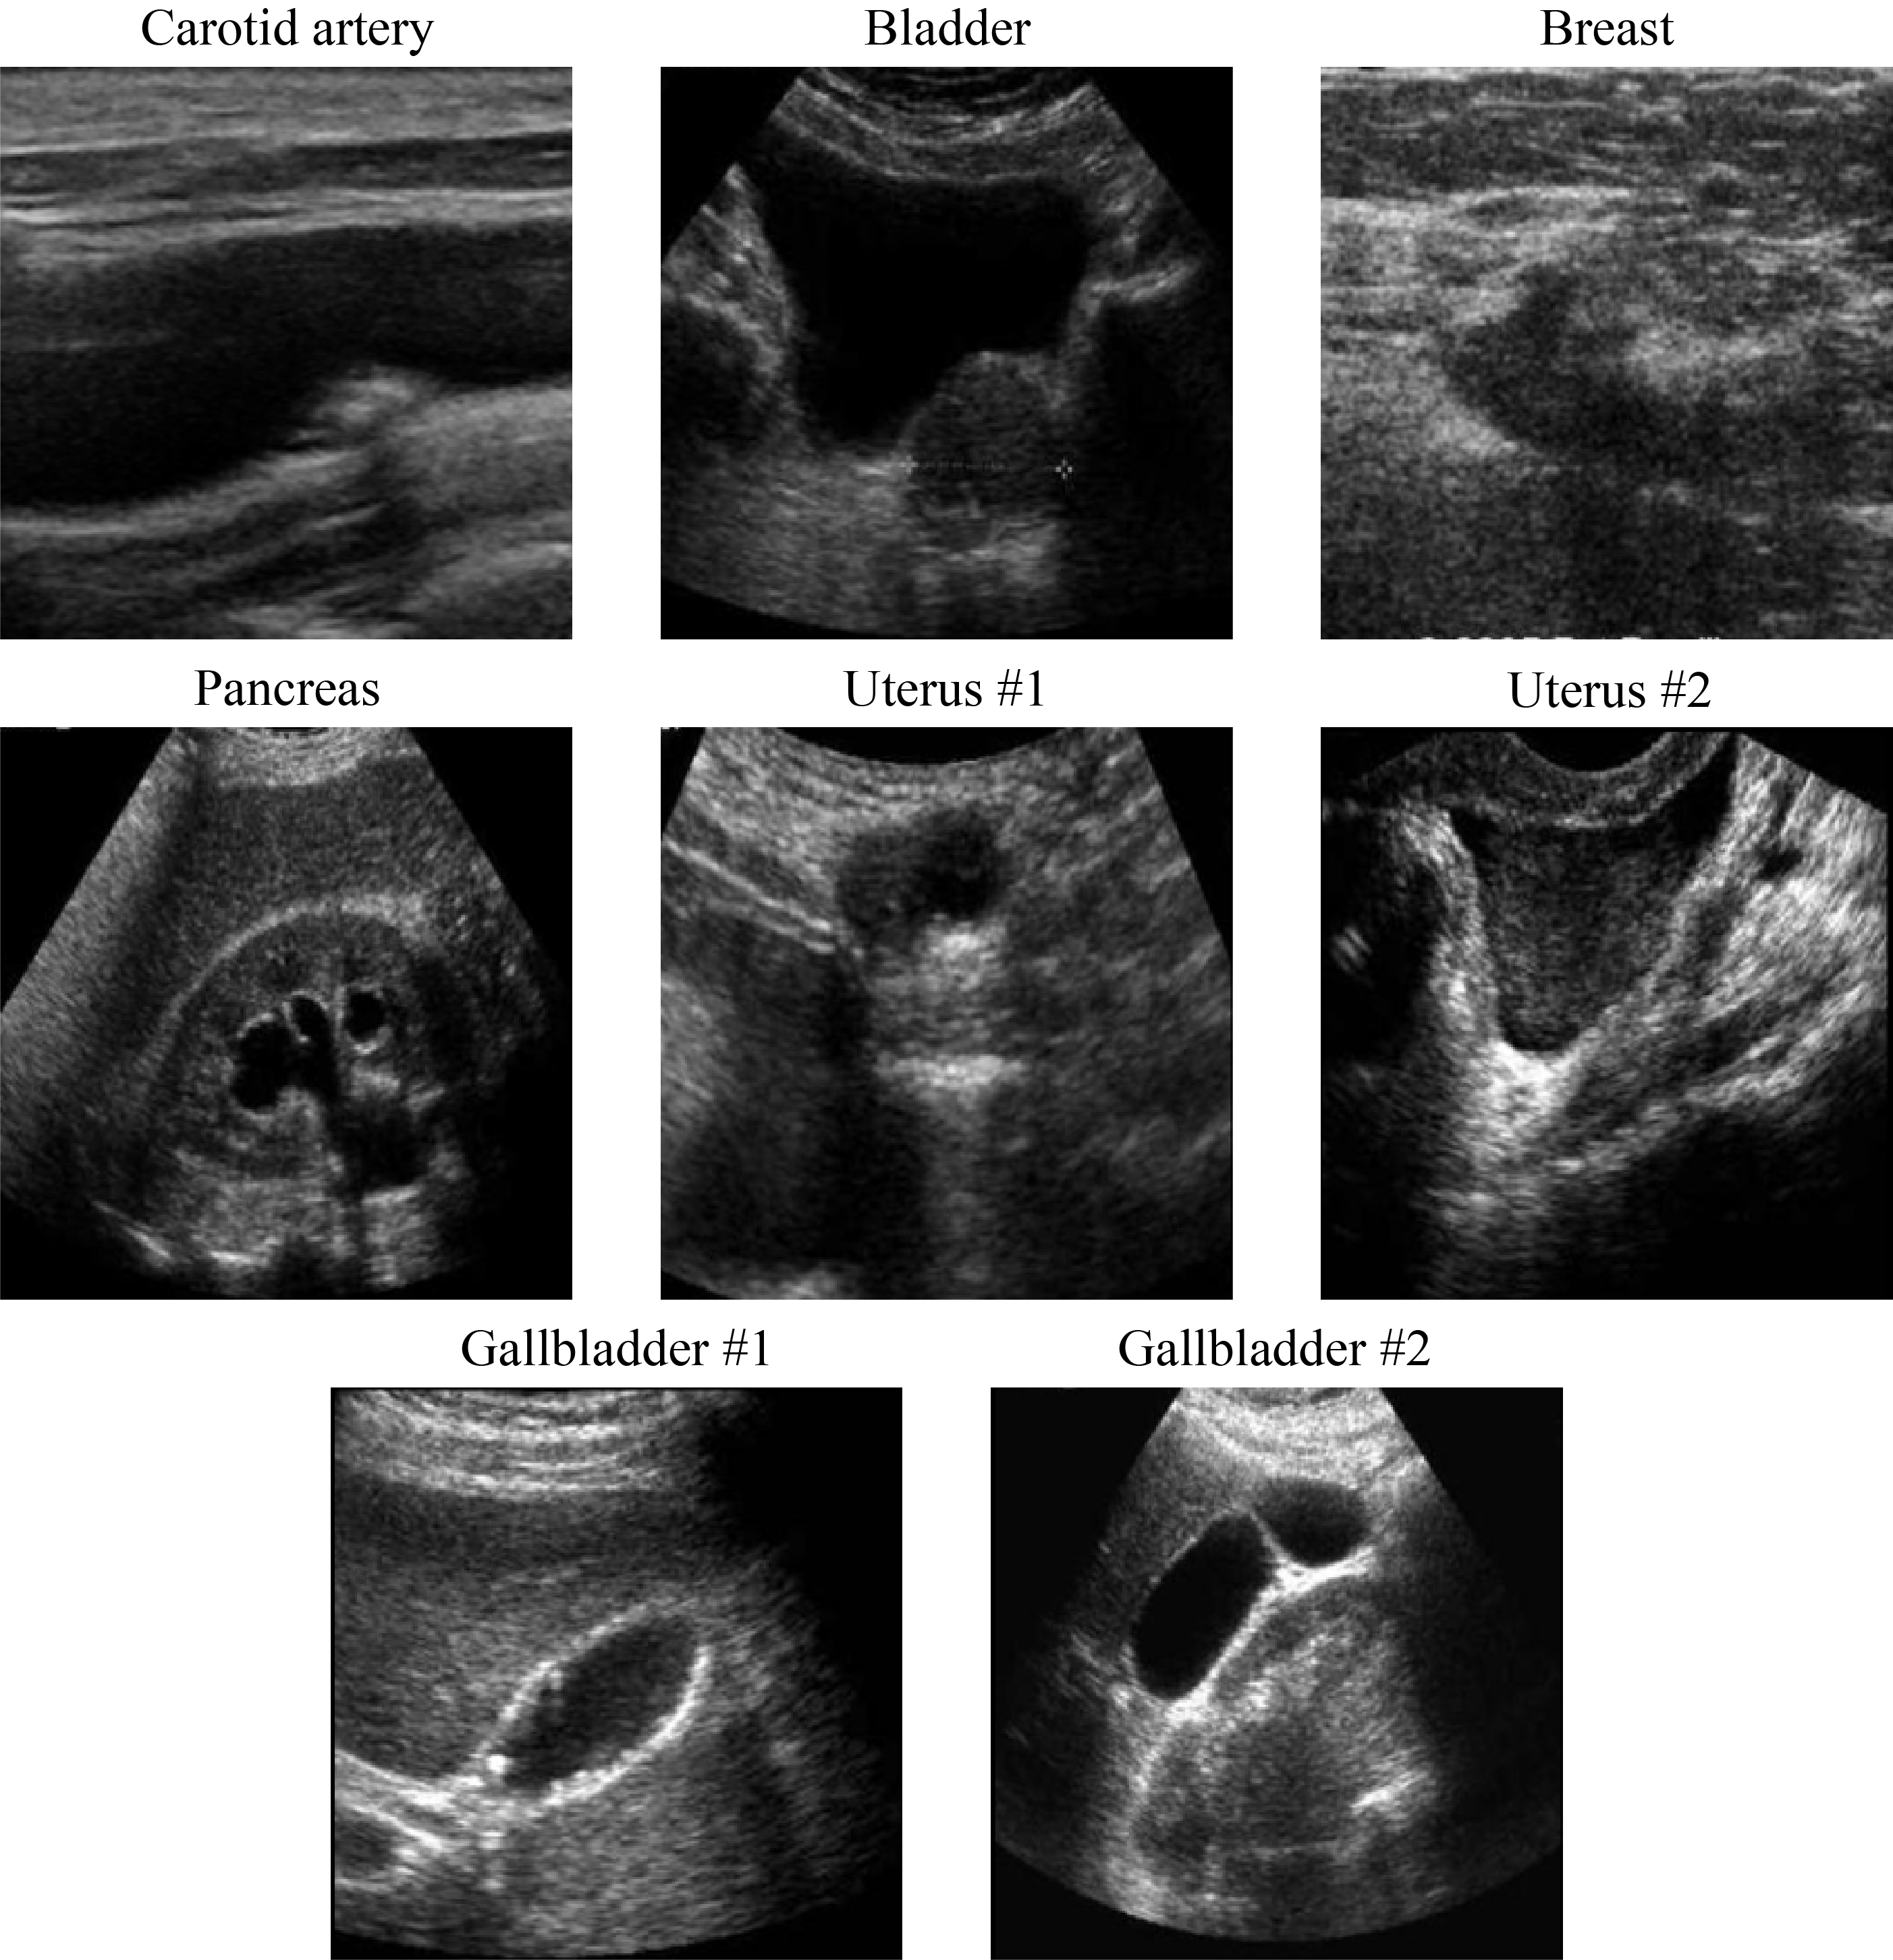
Introduction
Ultrasound
MRI
Fast acquisition
Lengthy acquisition
Affordable equipment
Expensive equipment
Low resolution
High resolution
Speckle noise
Low noise
Deep learning
Could deep learning bring the best of both worlds together?
Has recently become state of the art in many medical image denoising applications
Fig. 1: Noisy ultrasound images with visible speckle and low resolution features.
Inovação em Medicina e Engenharia Biomédica: Sinergias e Desafios

Slide 3
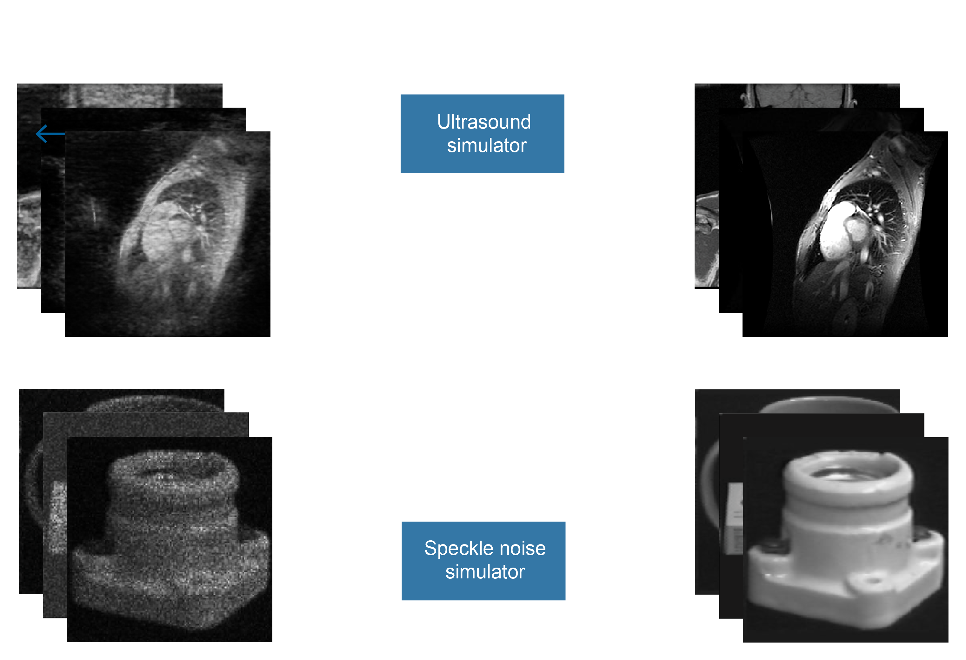
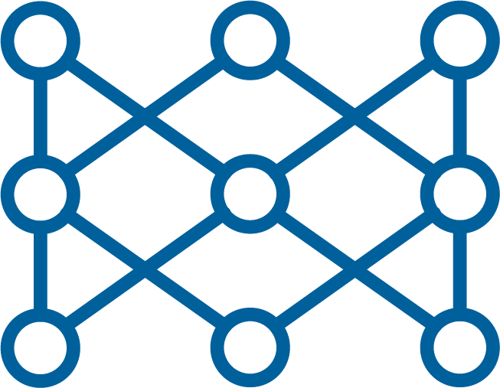
Methodology
Training
Model architecture
pix2pix
GAN specialized in image-to-image translation
State-of-the-art denoisers
RegGAN
OBNLM
De-QuIP
TVHTVM
Ultrasound Denoiser GAN
Evaluation Criteria
MAE
PSNR
RMSE
BRISQUE
Inovação em Medicina e Engenharia Biomédica: Sinergias e Desafios

Slide 4
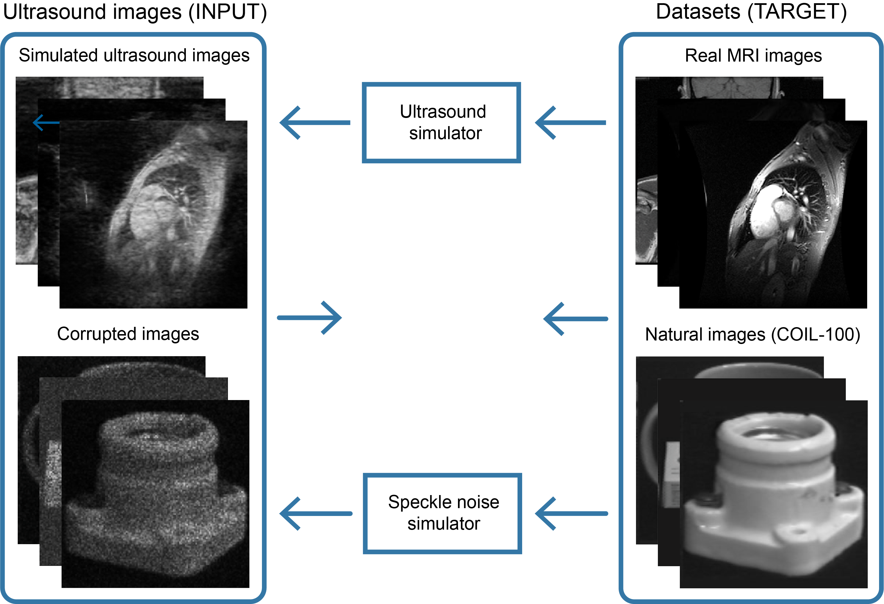


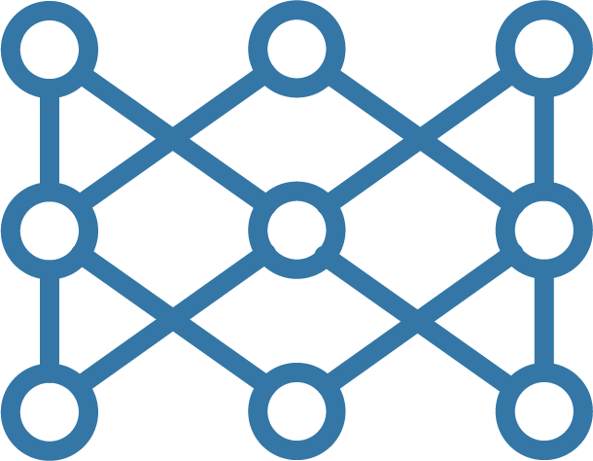
Methodology
Training
Model architecture
pix2pix
GAN specialized in image-to-image translation
Evaluation Criteria
State-of-the-art denoisers
MAE
PSNR
RegGAN
OBNLM
RMSE
BRISQUE
De-QuIP
TVHTVM
Ultrasound Denoiser
Ultrasound Denoiser GAN
Ultrasound Denoiser GAN
Ultrasound Denoiser GAN
Inovação em Medicina e Engenharia Biomédica: Sinergias e Desafios

Slide 5
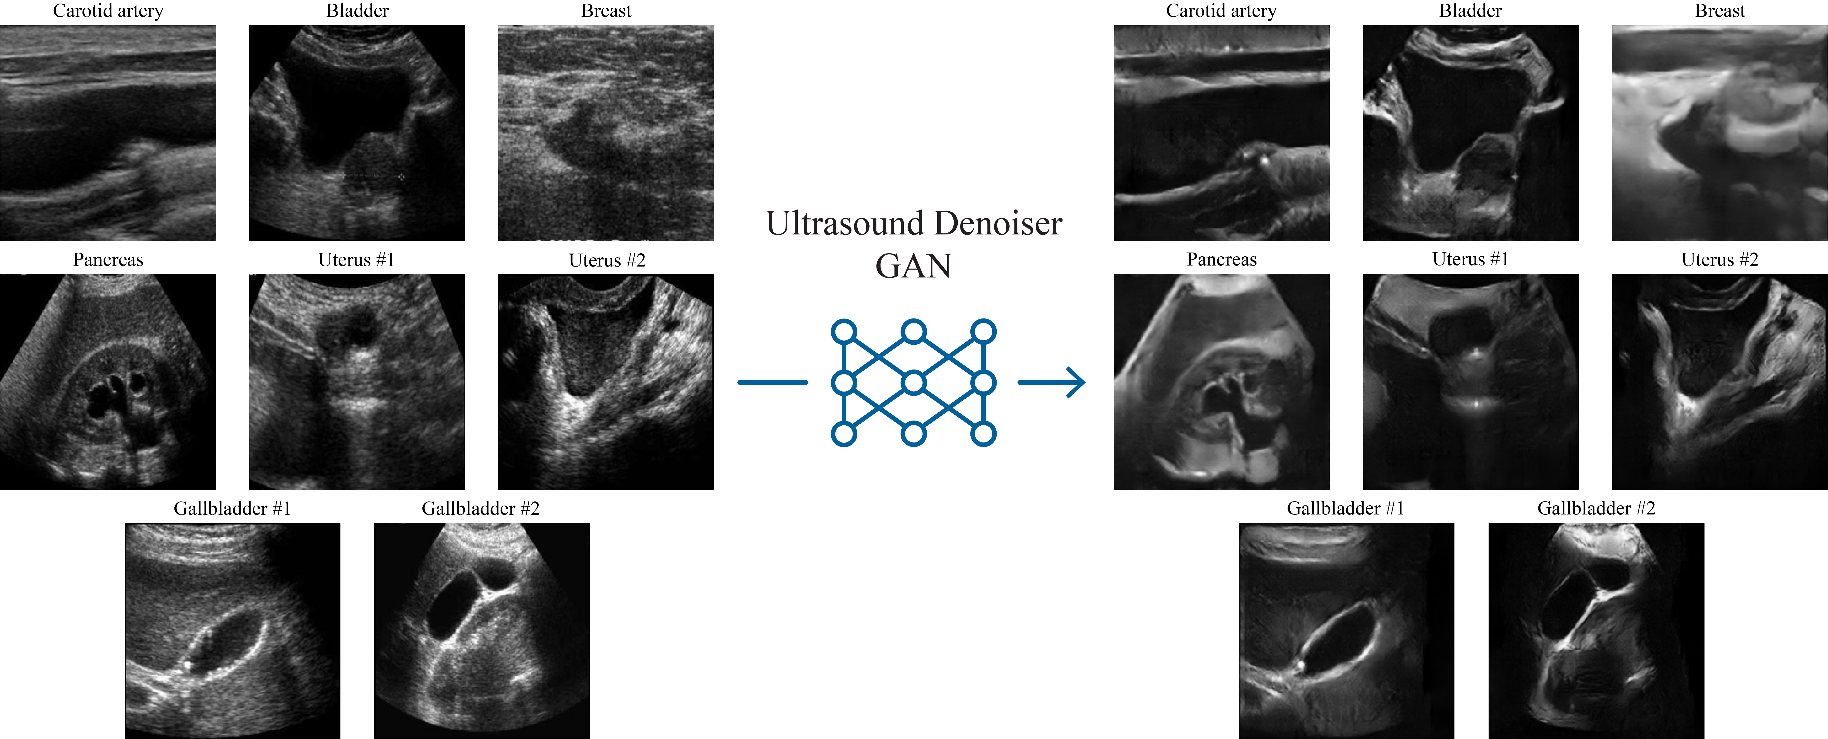
Results & Discussion
Speckle noise reduction
integrity of anatomical structures preserved
MRI-like features
Superior quantitative performance
Fig. 3: Denoising of medical ultrasound images using the proposed denoiser GAN. The denoised results resemble MRI images due to the cross modality transfer learning framework of this work. The integrity of anatomical structures is preserved, speckle noise is significantly reduced and reconstruction artifacts are avoided, also performing better than other state-of-the-art denoisers under several quantitative metrics.
Inovação em Medicina e Engenharia Biomédica: Sinergias e Desafios

Slide 6
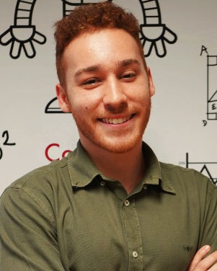
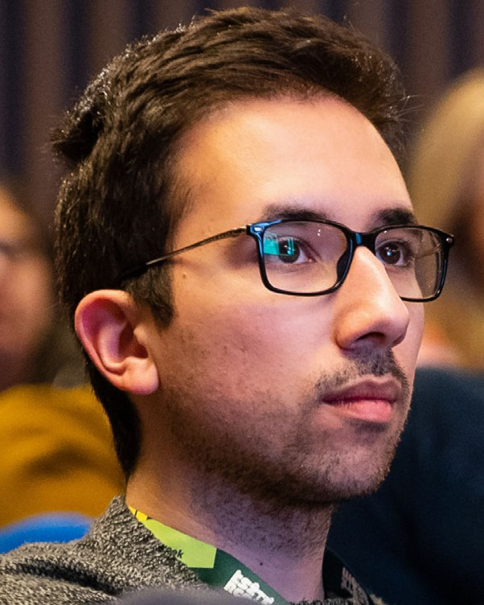
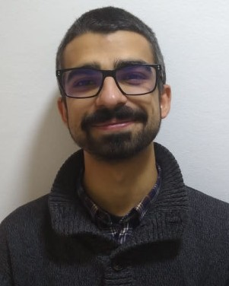

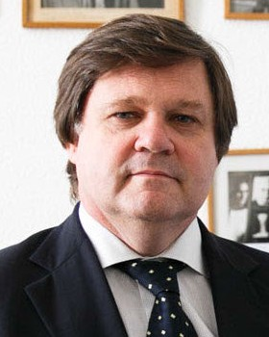
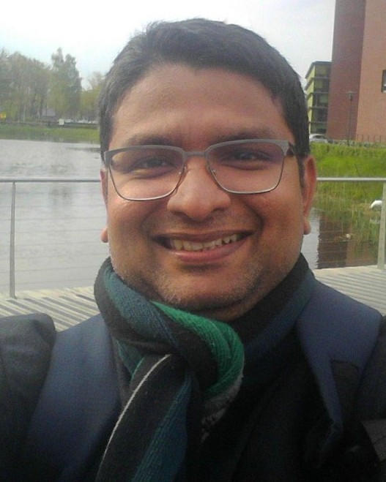
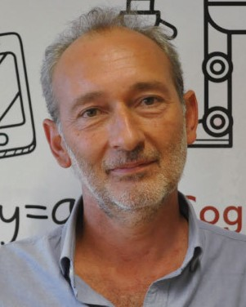
Acknowledgements
Team members
Funding
Affiliations
I-CARD: | 2022.02665.PTDC
Diogo F. Vieira
Afonso Raposo
António Azeitona
Grants: | 10.54499/LA/P/0083/2020
 | 10.54499/UIDP/50009/2020
 | 10.54499/UIDB/50009/2020
Luís M. Pedro
Manya Afonso
João Sanches
Check out our paper!
doi: 10.1109/ACCESS.2024.3381630
Inovação em Medicina e Engenharia Biomédica: Sinergias e Desafios

Slide 7
References
Refs
Inovação em Medicina e Engenharia Biomédica: Sinergias e Desafios

